Slide 1
Sita Runfold Quarry

Slide 2
Old Hogs Back

Slide 3
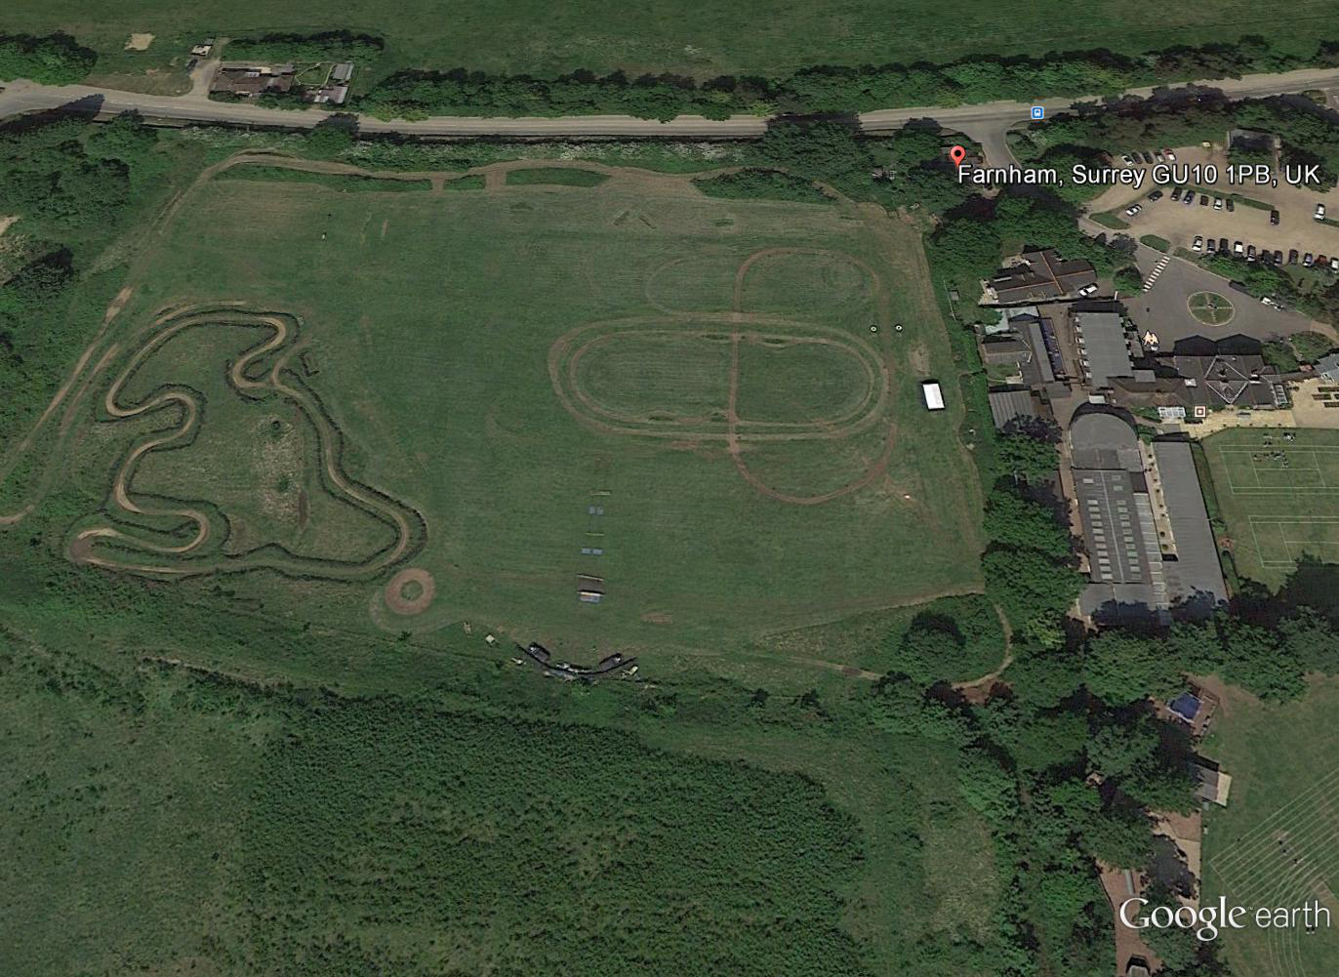
Barfield School and field

Slide 4
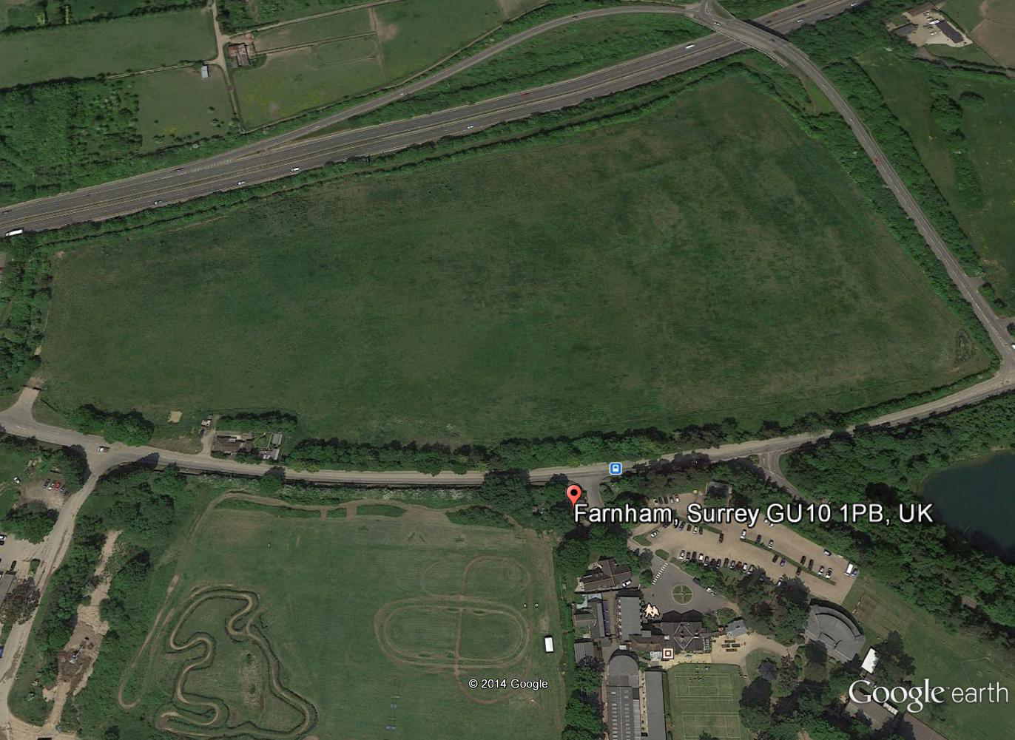
Runfold North

Slide 5
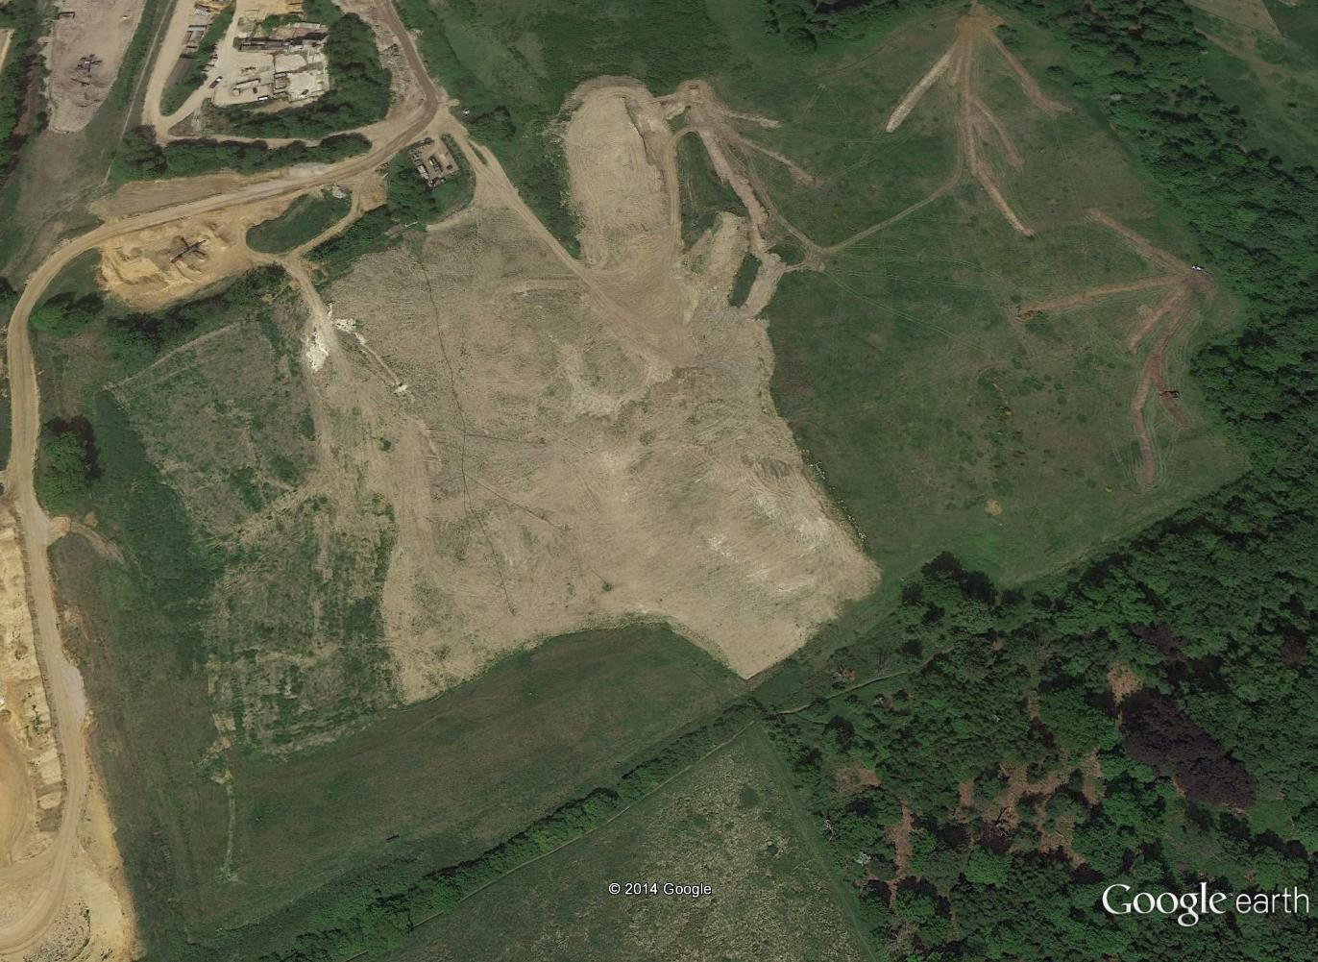
Area B

Slide 7
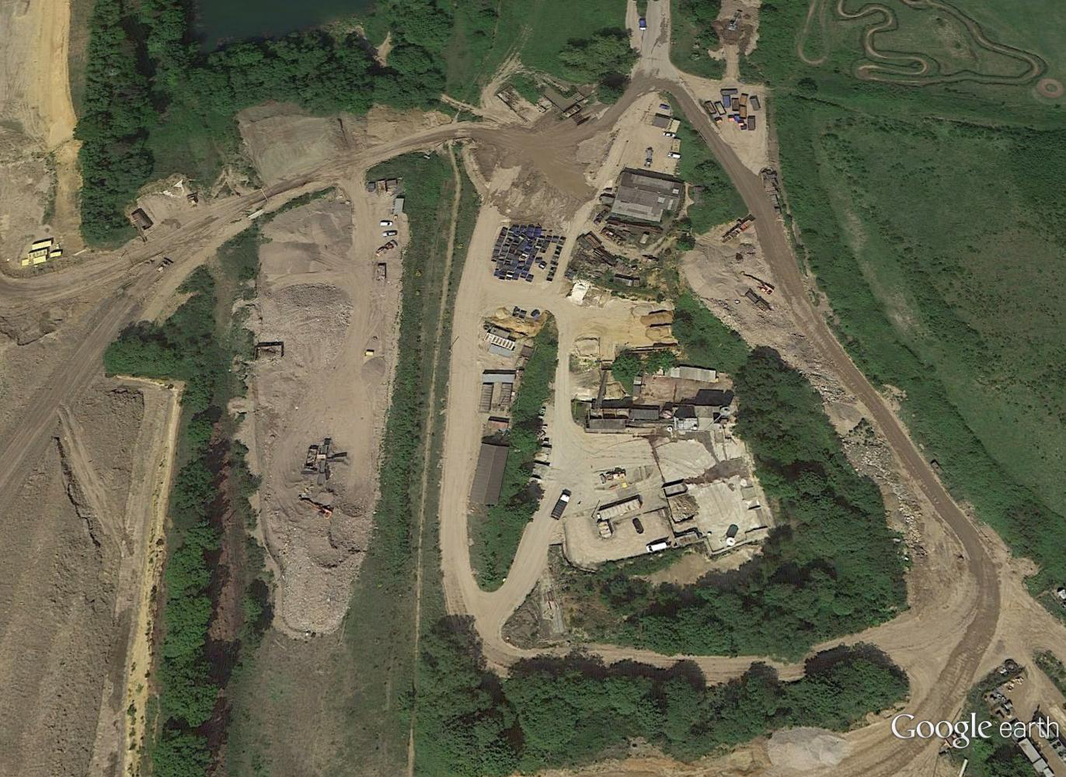
ROMP
ROMP

Slide 8
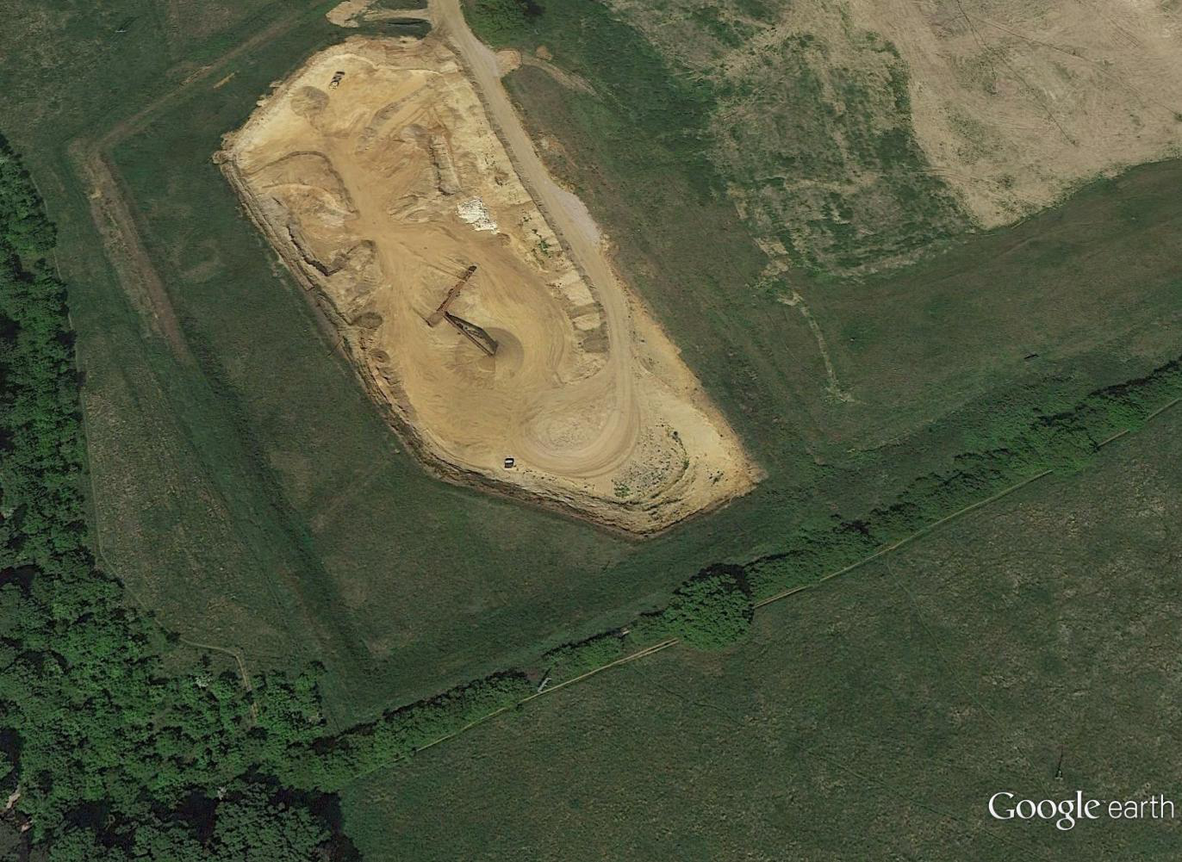
Area C

